Slide 1


High altitude environmental surveys above the Navajo Nation (Part 2)

Slide 2
Methane across the Navajo Nation
Allyssa Wynter Joe

Slide 3
What is Methane CH₄?
The simplest of all hydrocarbon (i.e., organic) molecules.
One carbon and four hydrogens atoms
A naturally occurring gas resulting from the metabolisms of most animals and biogeochemical degradation of organic substances.
Notes:
Methanogens: Bacteria and/or Archaea that produce methane as a result of anaerobic metabolism.

Slide 4
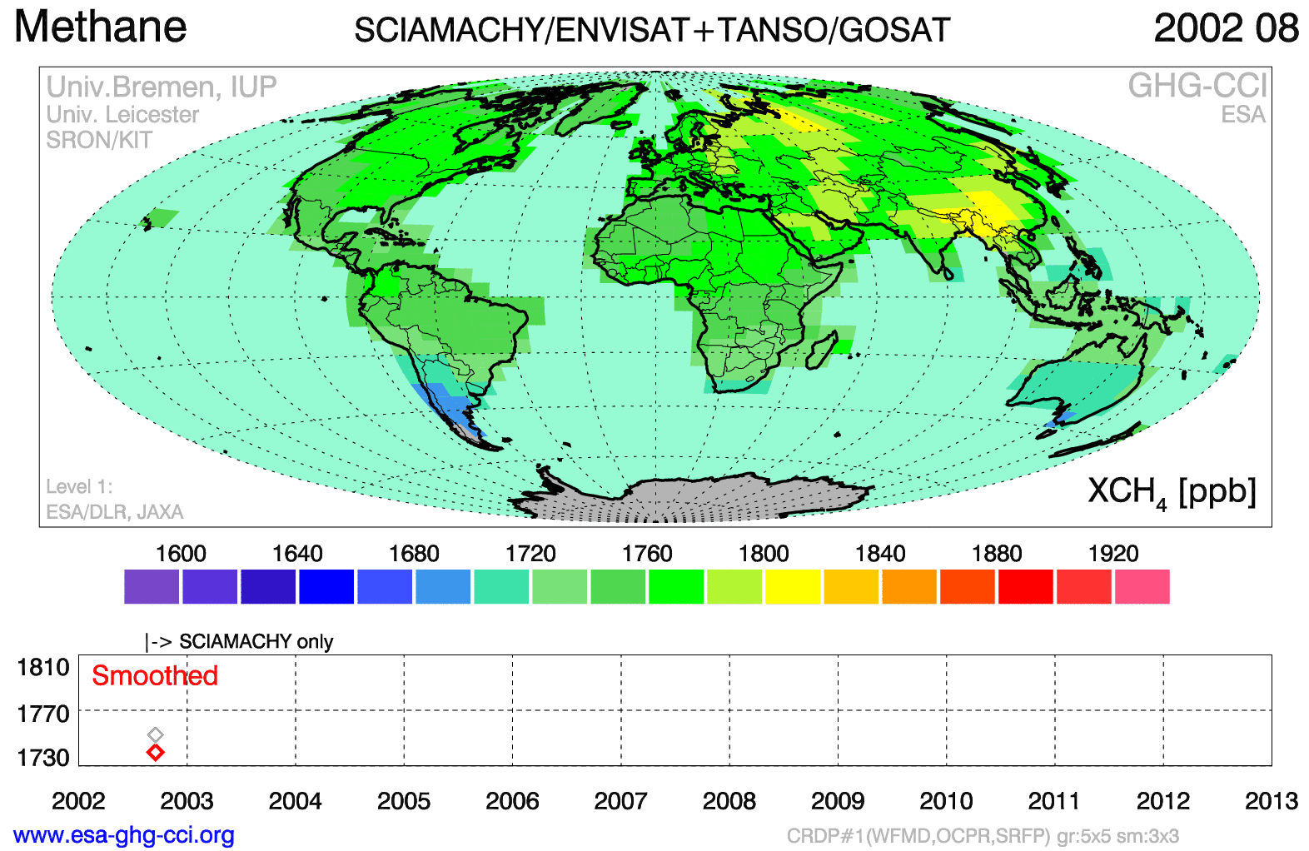
Anthropogenic sources of CH₄
Methane is increasing on the global scale, but highly variable on the local-to-regional scale.
Notes:
From down the roads to the next community.

Slide 5
Why does it matter?
CH₄ is less abundant than other atmospheric gases but holds proportionately more heat, resulting in increased “greenhouse effect”, a major culprit of global climate change.
Notes:
Methane is the cleanest green house gas but has the danger just
Methane is also a cheap, relatively clean, and useful fuel. Methane is increasingly being harvested from waste water treatment plants.

Slide 6
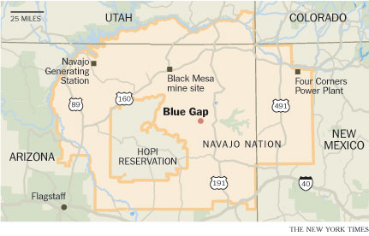
Study of CH₄ on the Navajo Nation
Anthropogenic sources:
Agriculture (farming, animal waste, and crops)
2. Power plants: Four Corners Power Plant and Navajo Generating Station
However: Little is known of the CH₄ concentrations on the Navajo Nation

Slide 7
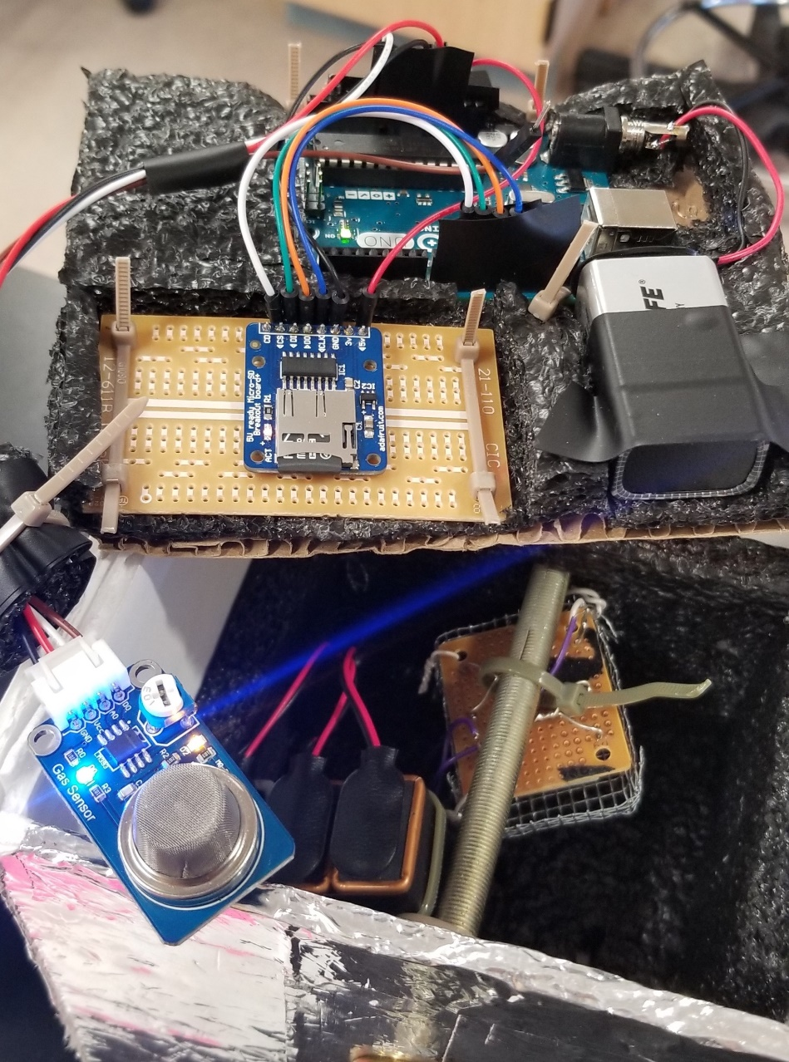
Construction of Ch₄ payload
Components:
Arduino microcontroller
MQ-4 Methane sensor
Micro-SD Breakout board
Other payload components:
  Battery ( four 9-volts)
  Heater
  Screw

Slide 8
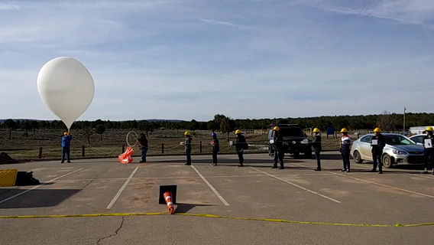
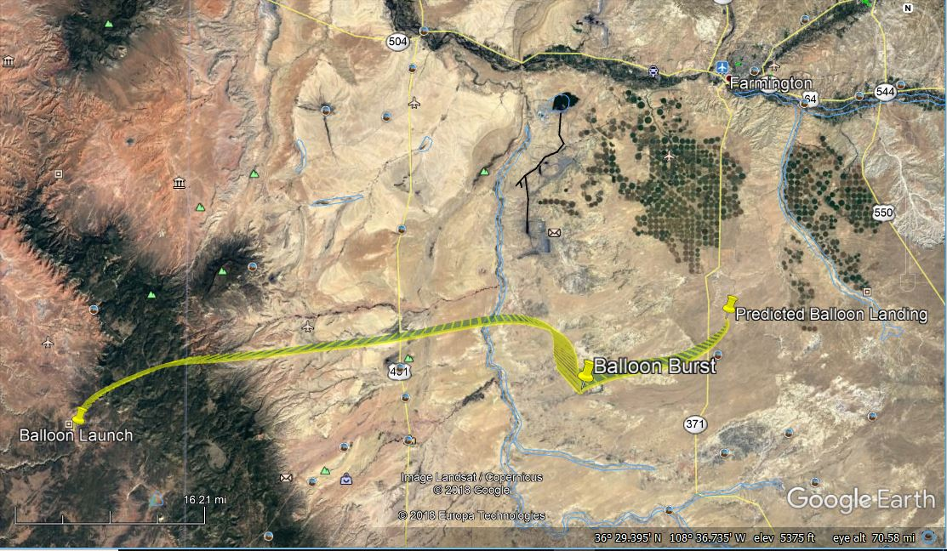
The Flight
Launch
Flight path
High Altitude balloon filled with Helium
Pops in the atmosphere around ~91,000 feet
Takeoff at Dine’ College in Tsaile, AZ

Slide 9
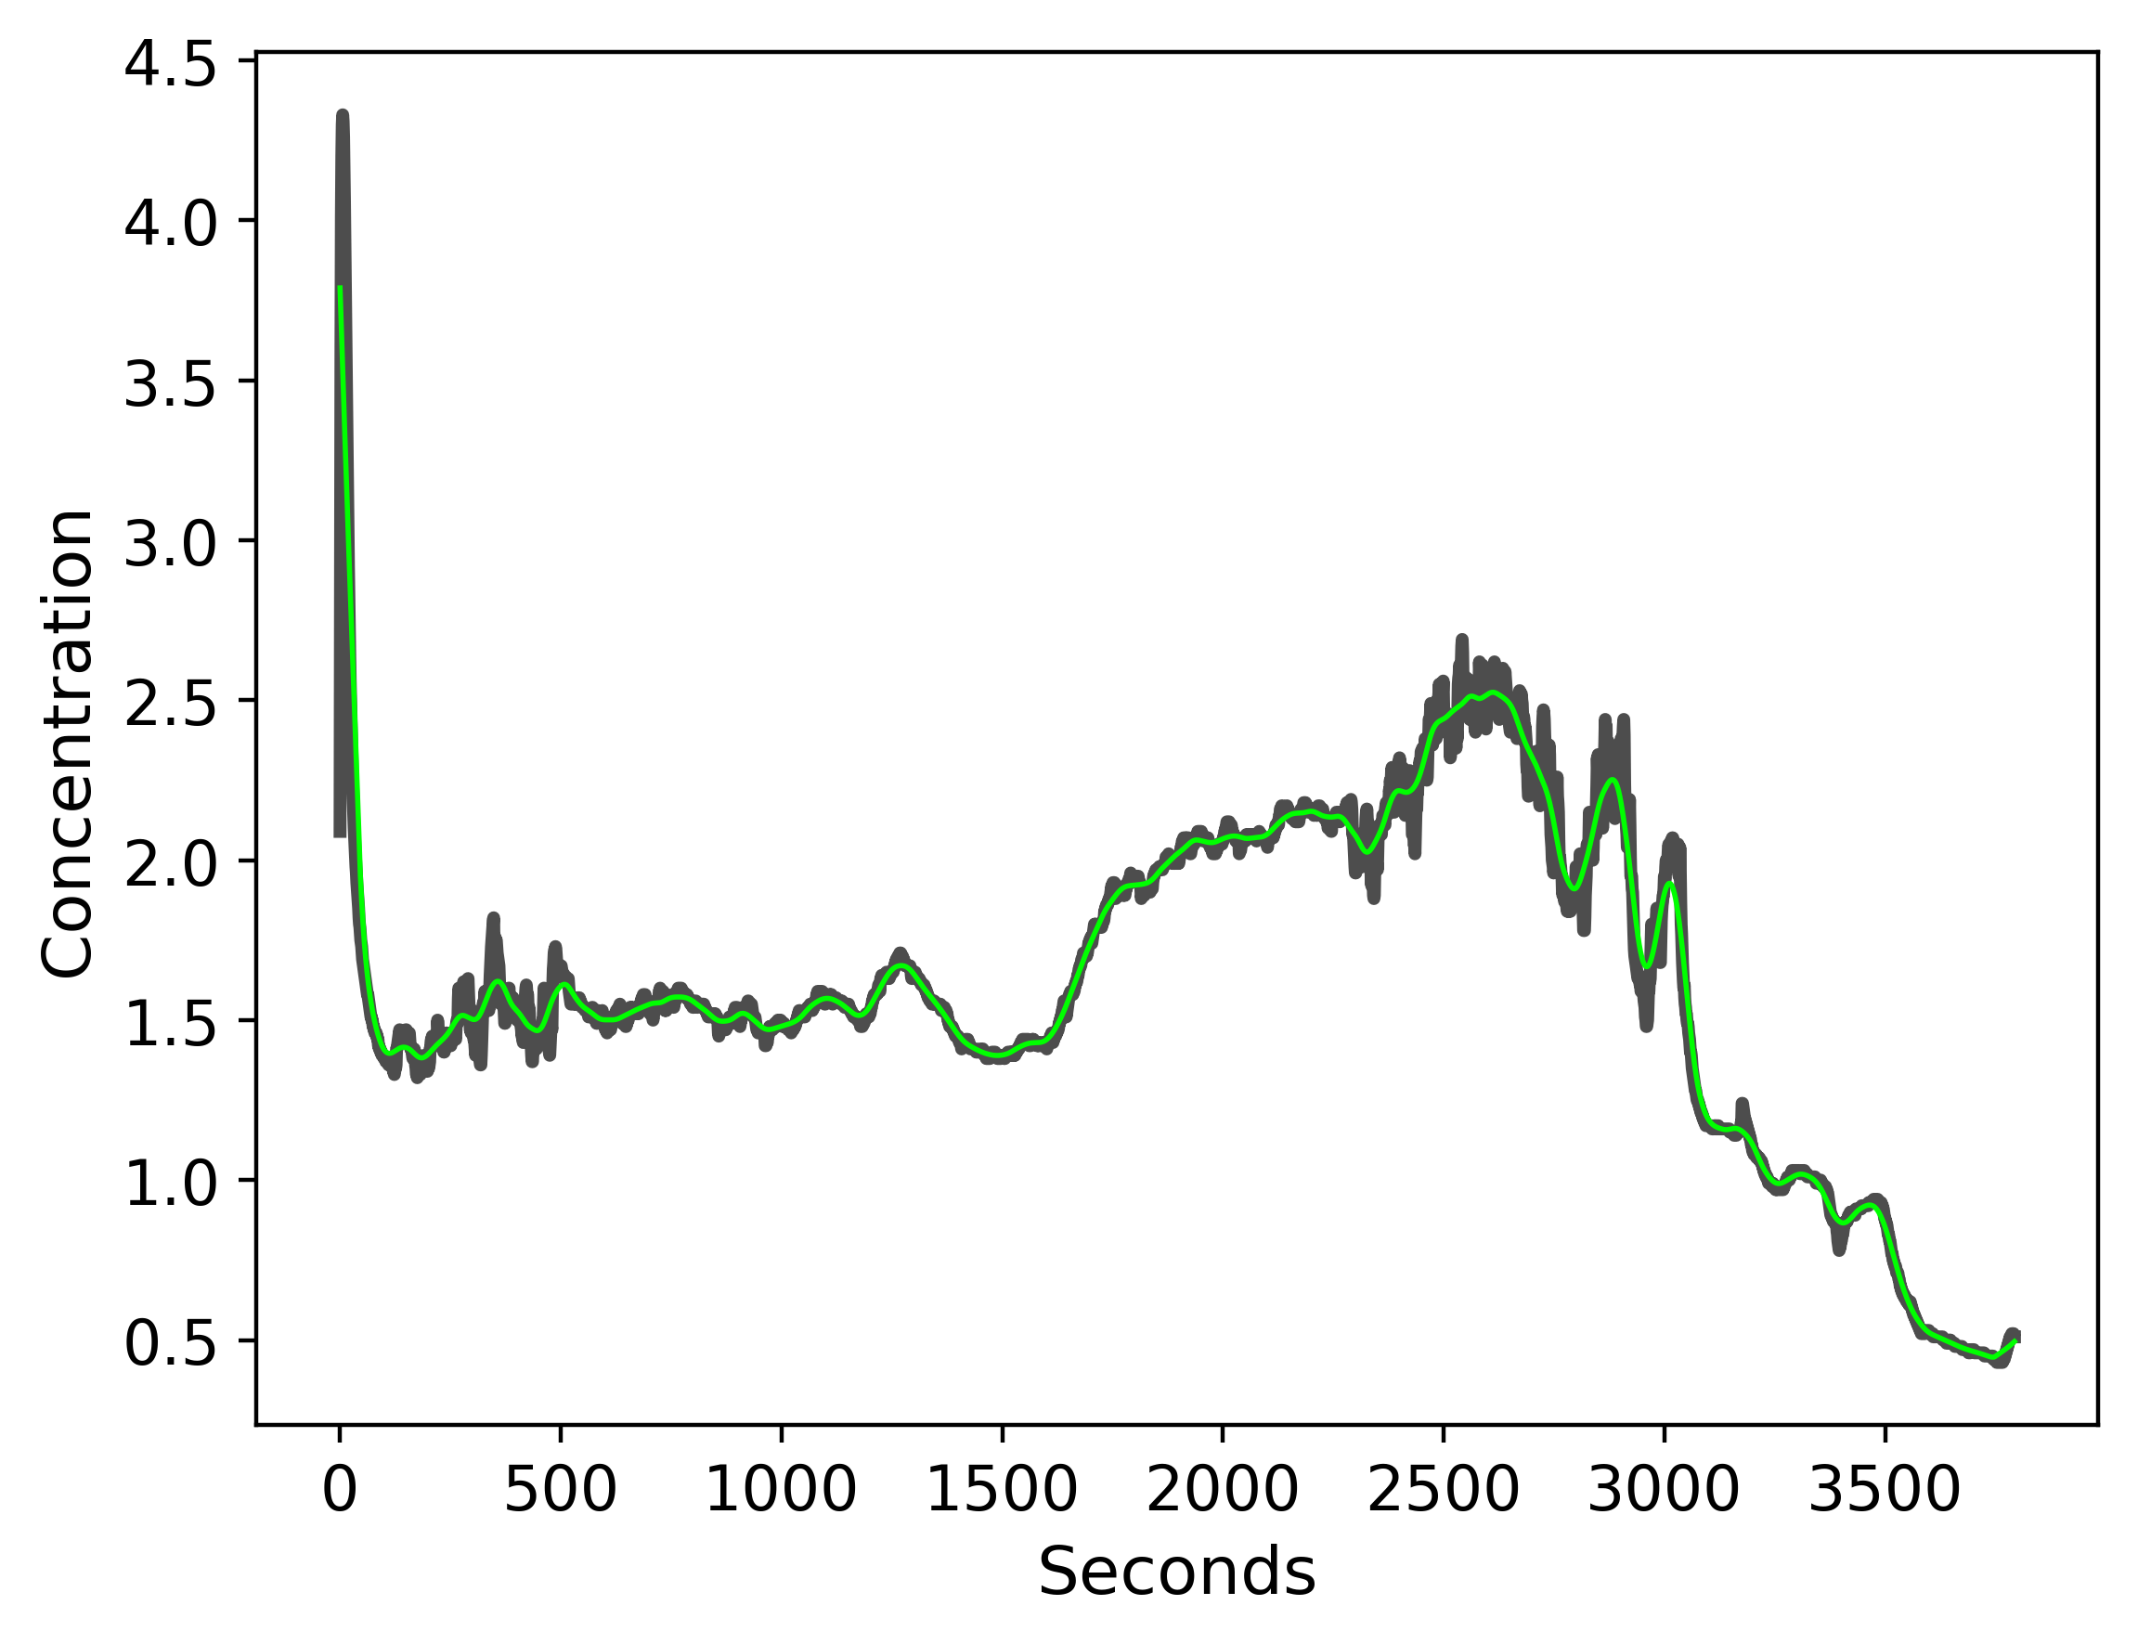
Raw and smoothed data
Locally weighted scatter smoothing revealed relatively little “noise”.

Slide 10
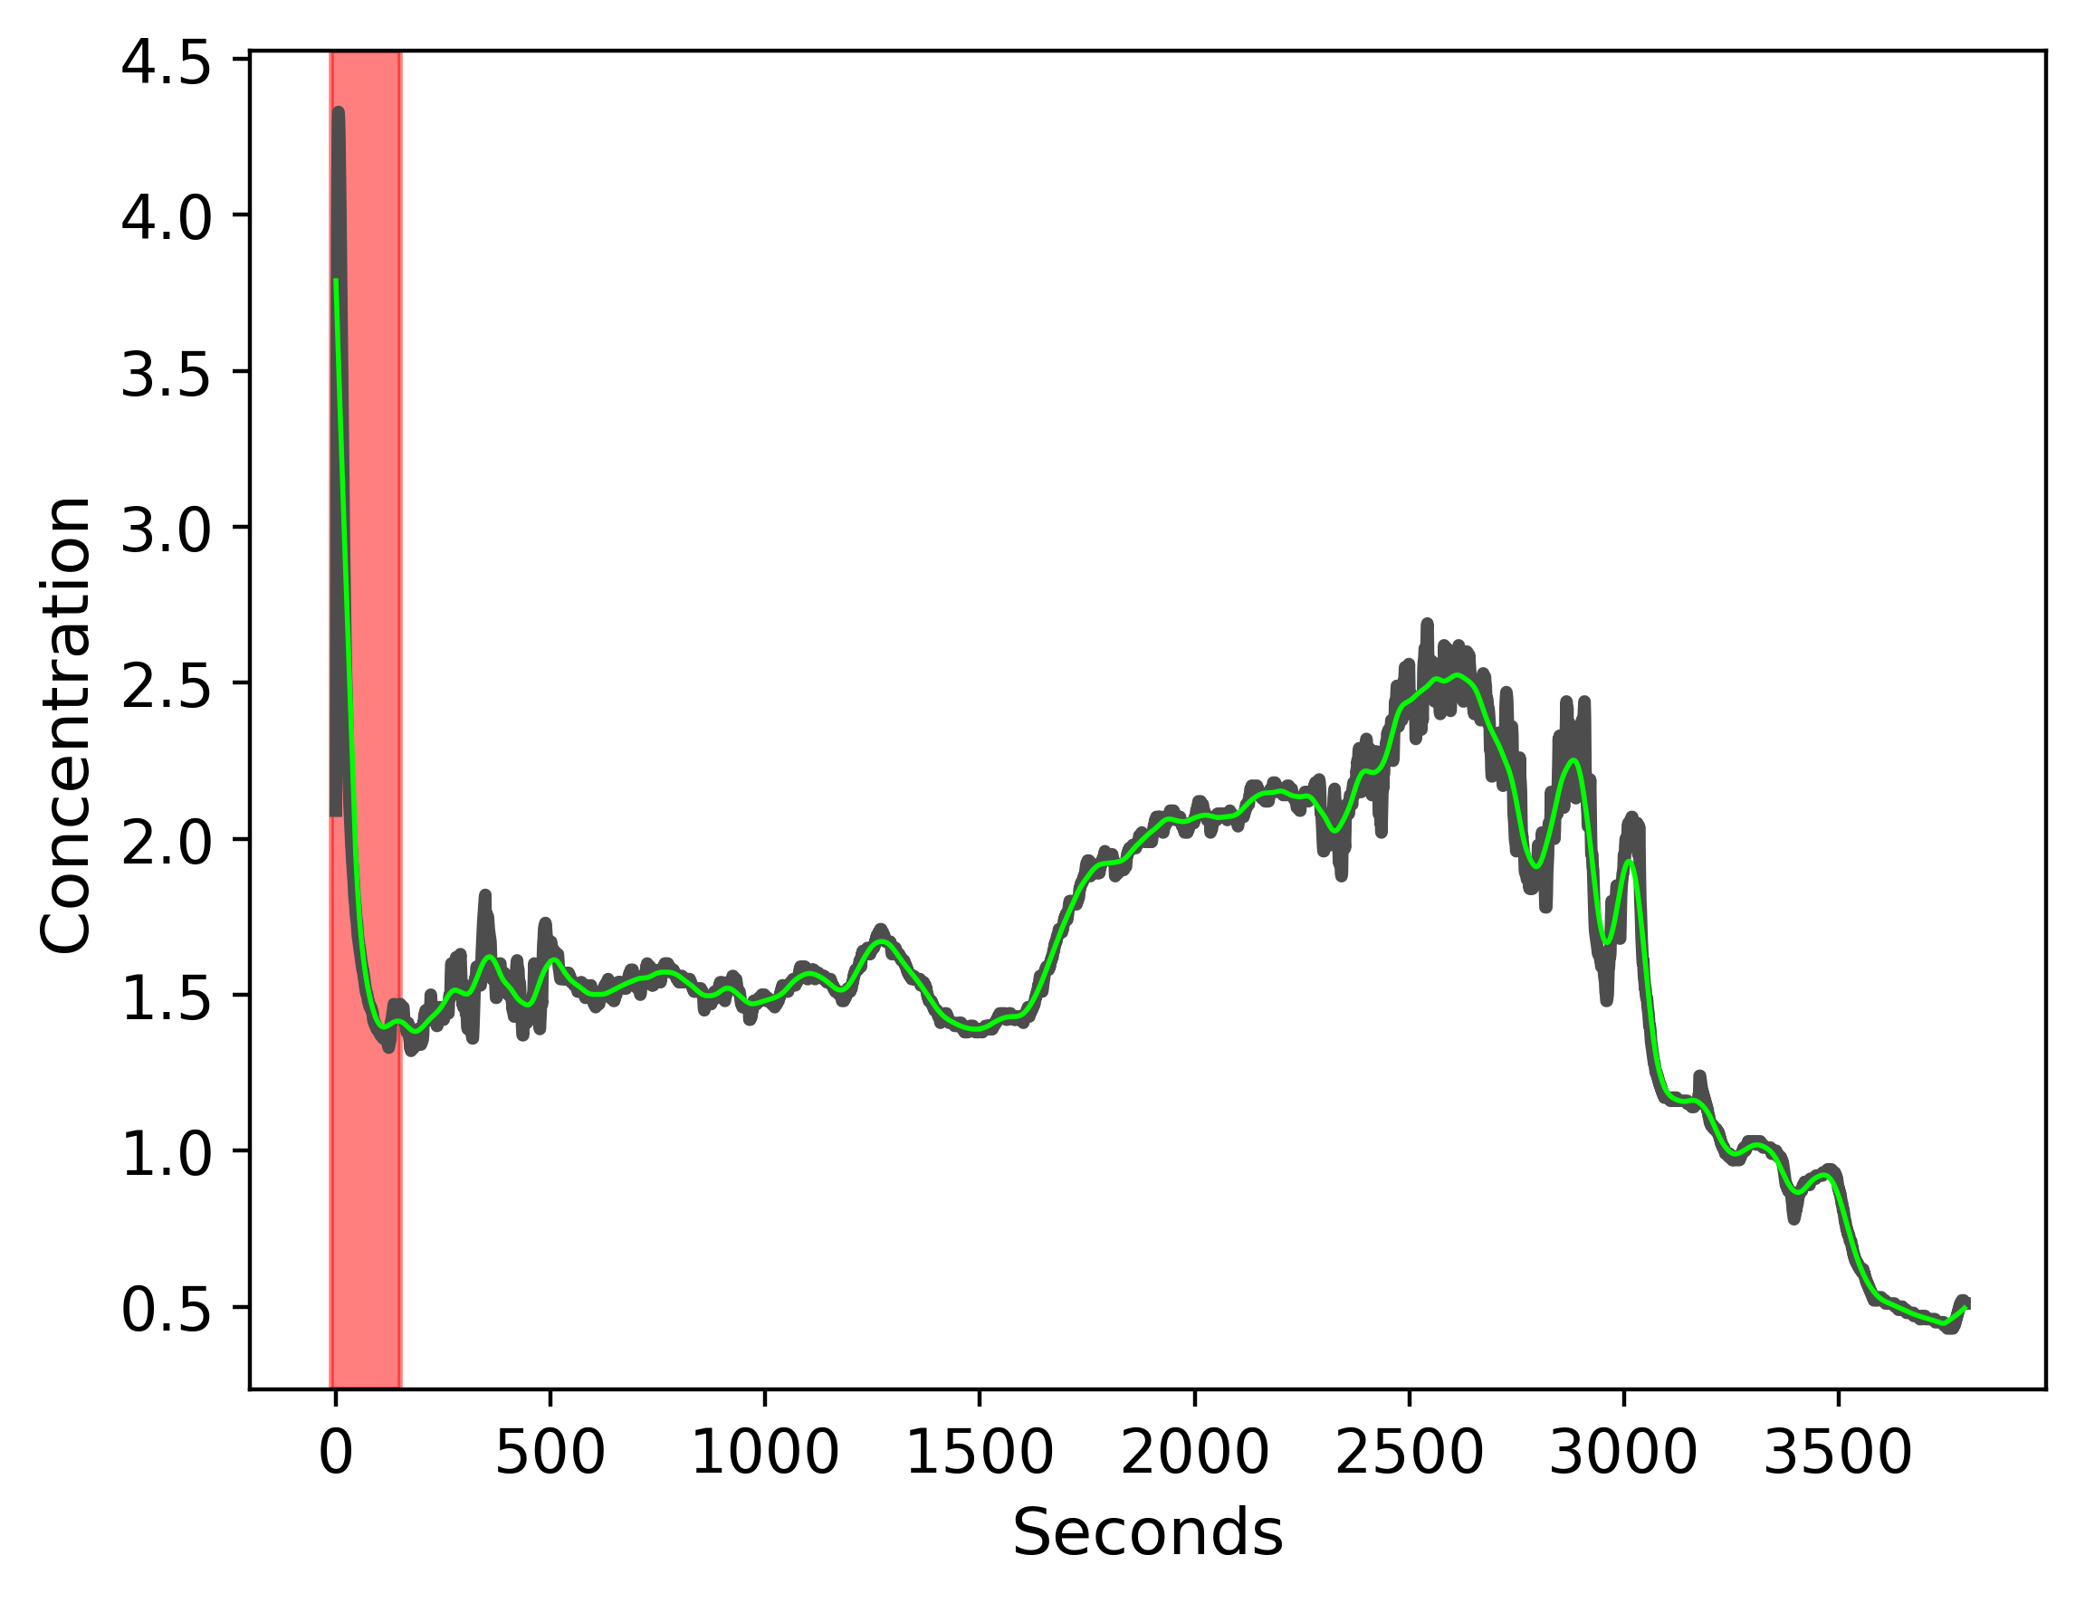
Expected calibration
Initial sharp increase and decrease followed the expected behavior of the sensor until it reaches a baseline (y ~1.3).

Slide 11
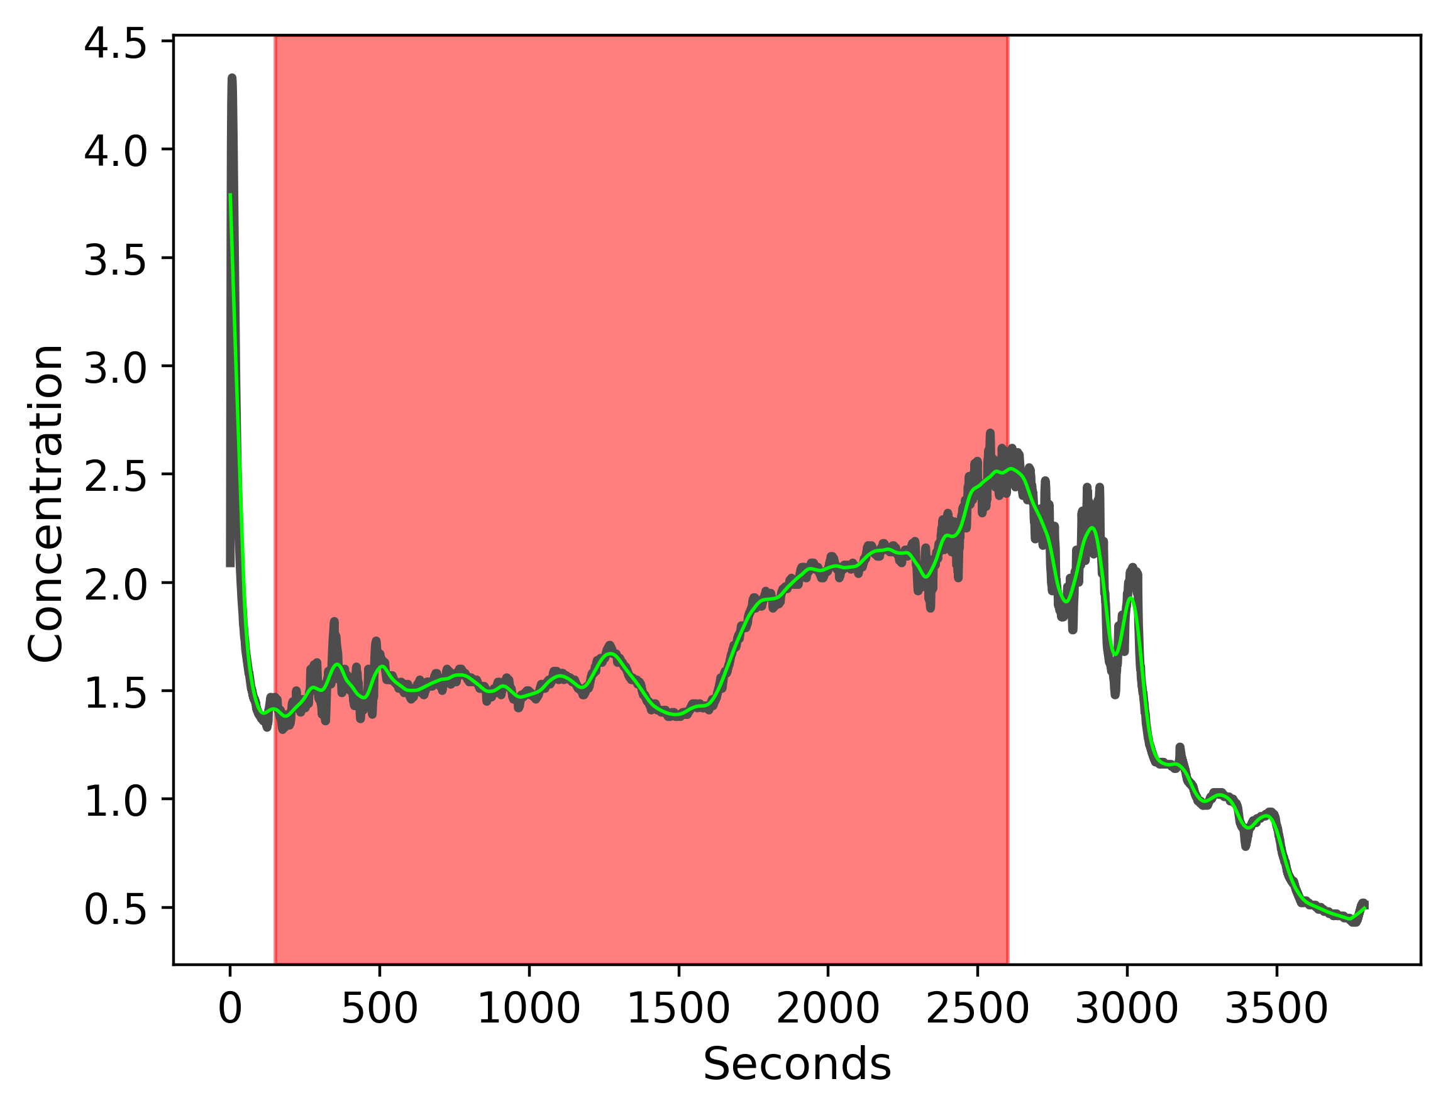
Expected increase
After reaching baseline, concentration (voltage) generally increased for about the next 40 min.

Slide 12
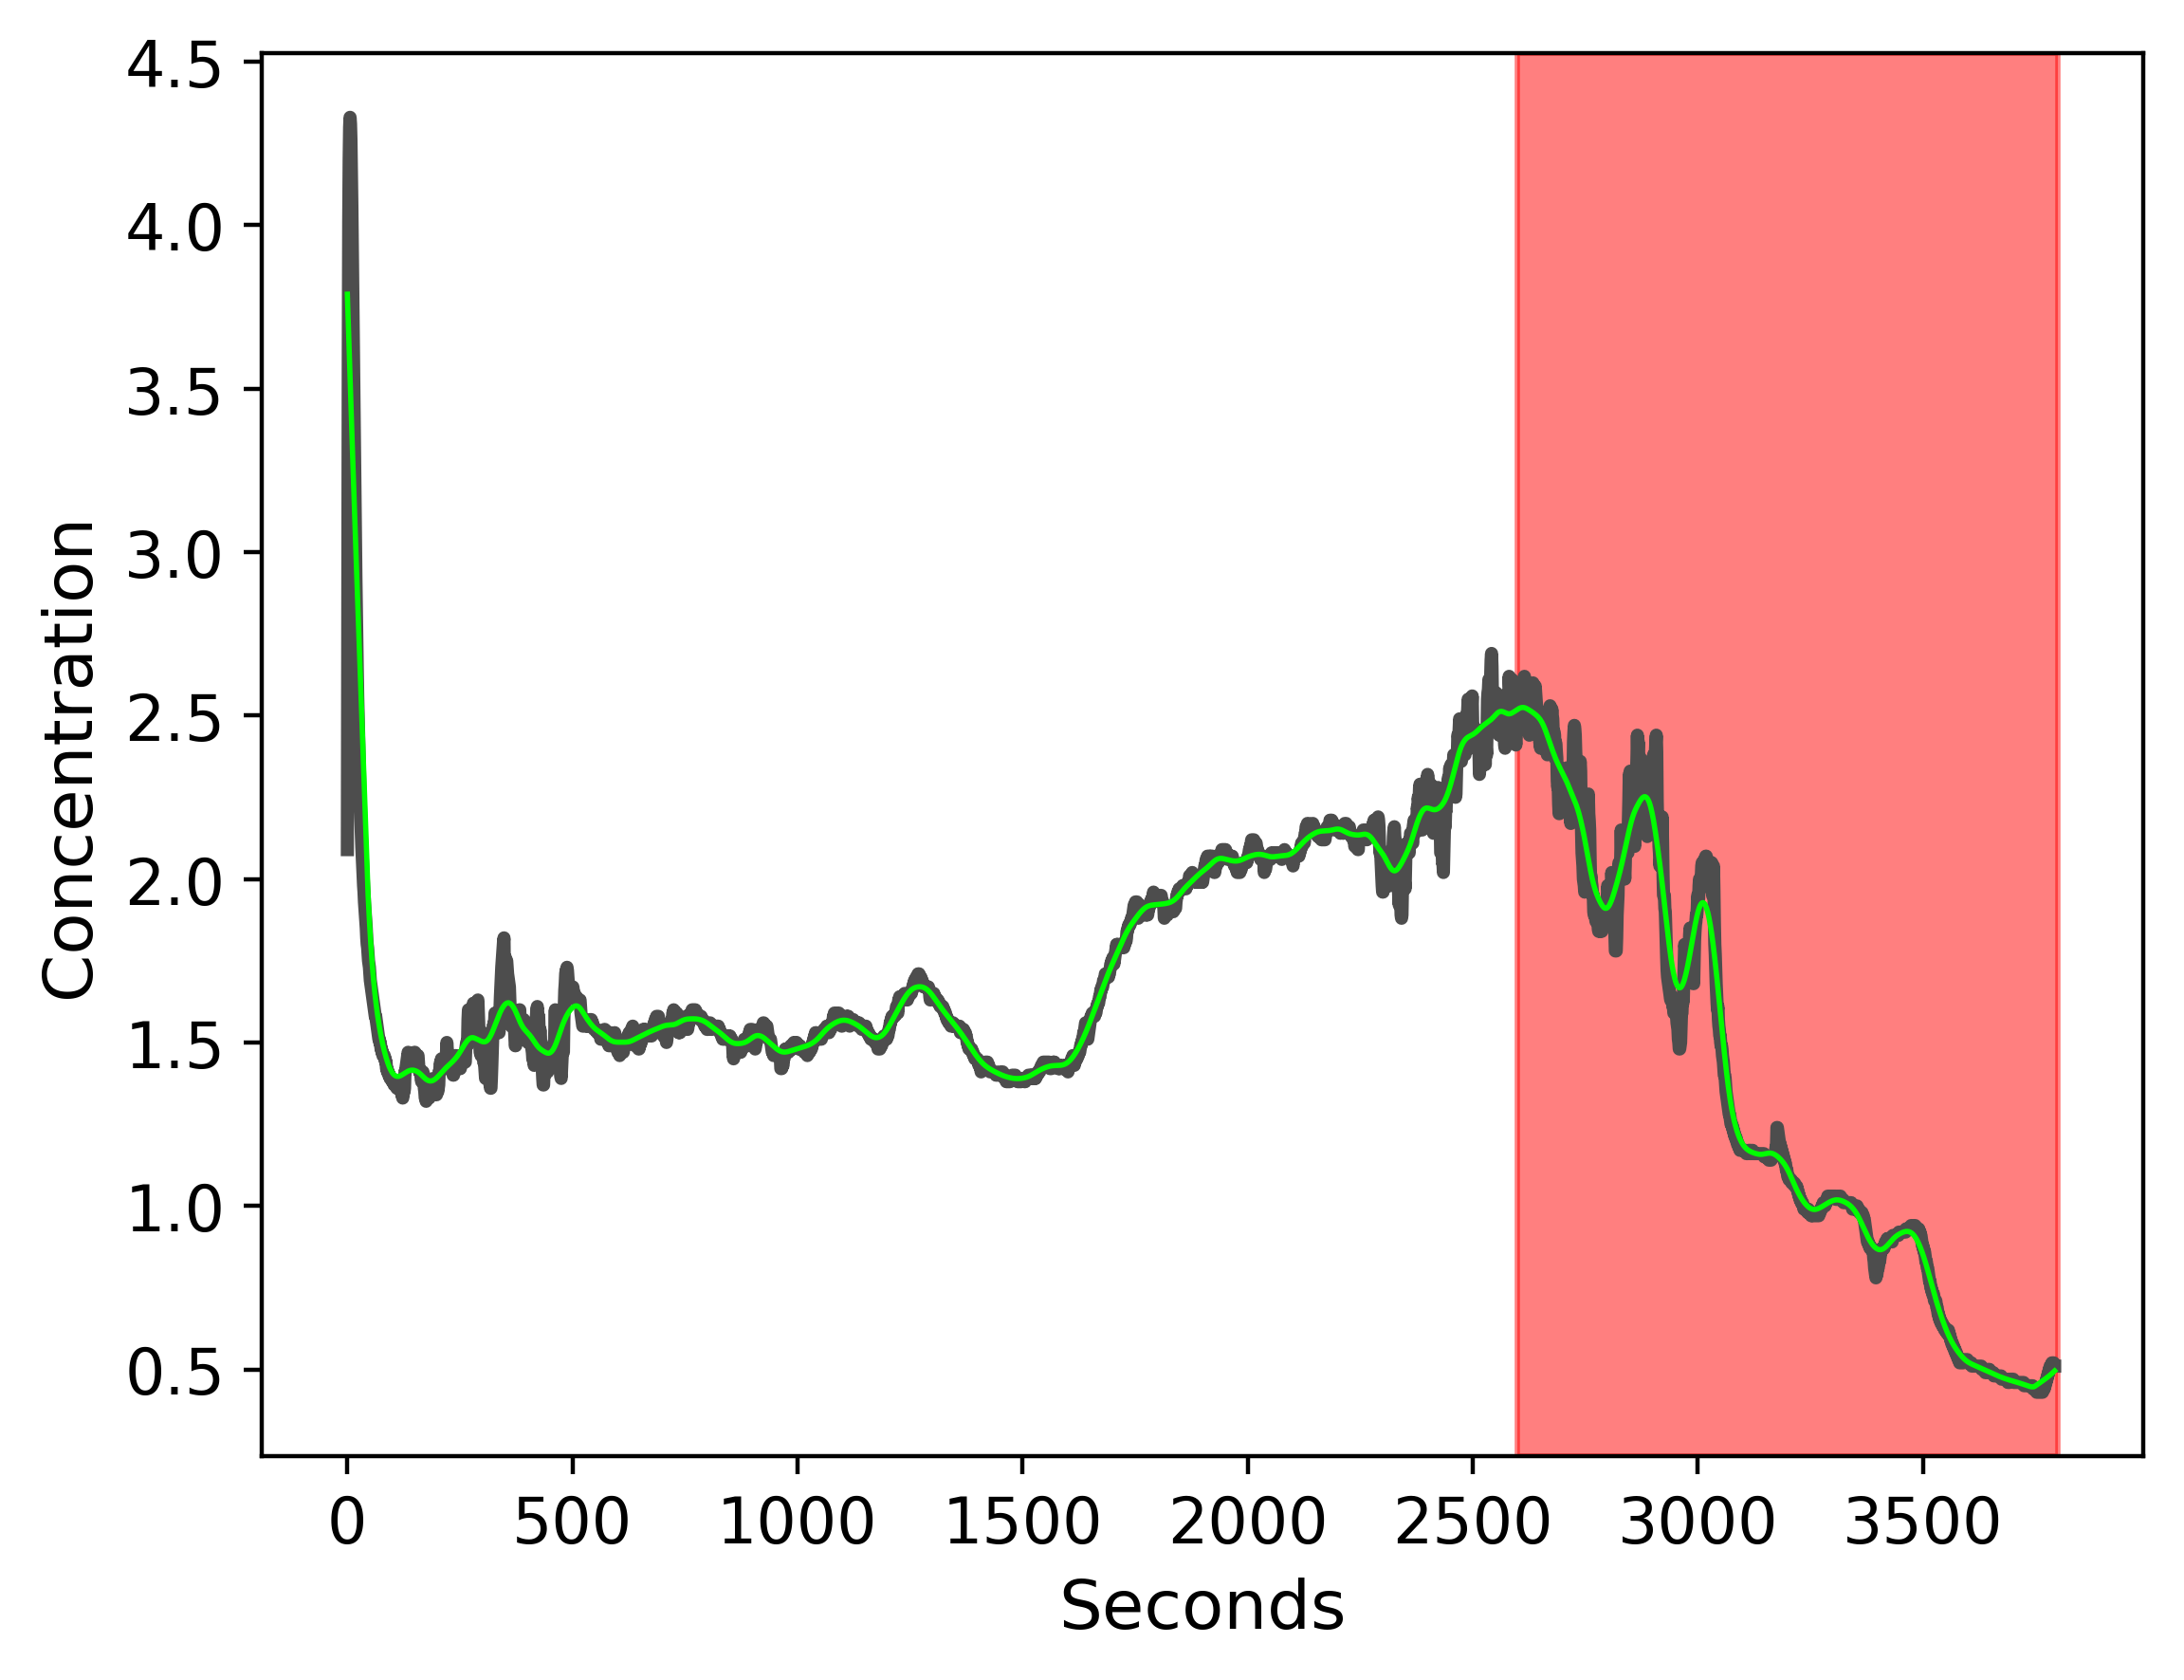
Eventual sharp decrease
At around 10am, CH₄ concentration (voltage) decreased sharply to well below baseline.

Slide 13
Carbon Dioxide Within our Atmosphpere
Jamie Begay
B.S. Student in Biology

Slide 14
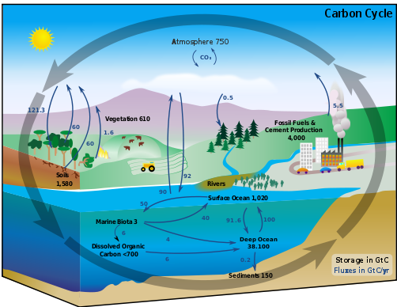
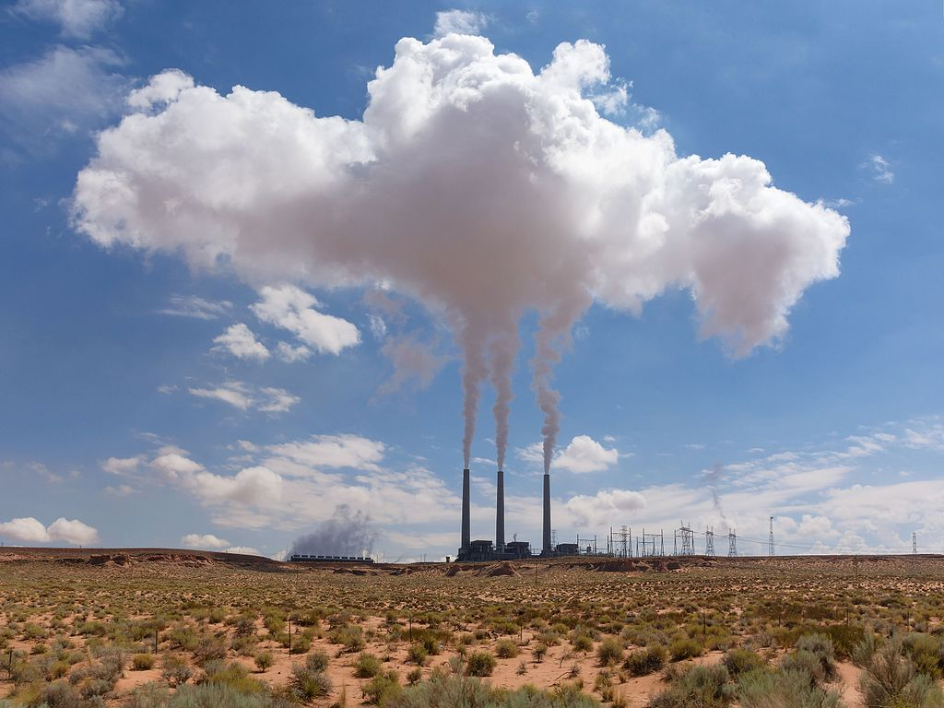
What is Carbon Dioxide?

Slide 15
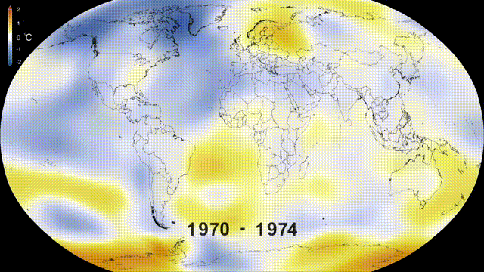
Increasing Levels of Carbon Dioxide
Climate Change: increasing temperatures, waters rising, impacting agriculture, effecting the wildlife.
Acid Rains: gas waste from burning fossil fuels combines with the moisture of our atmosphere.
Greenhouse Effect: air pollution trapped within the Earth’s atmosphere creating ground level ozone.
Health Effect: increasing oxygen making it difficult to breath.

Slide 16
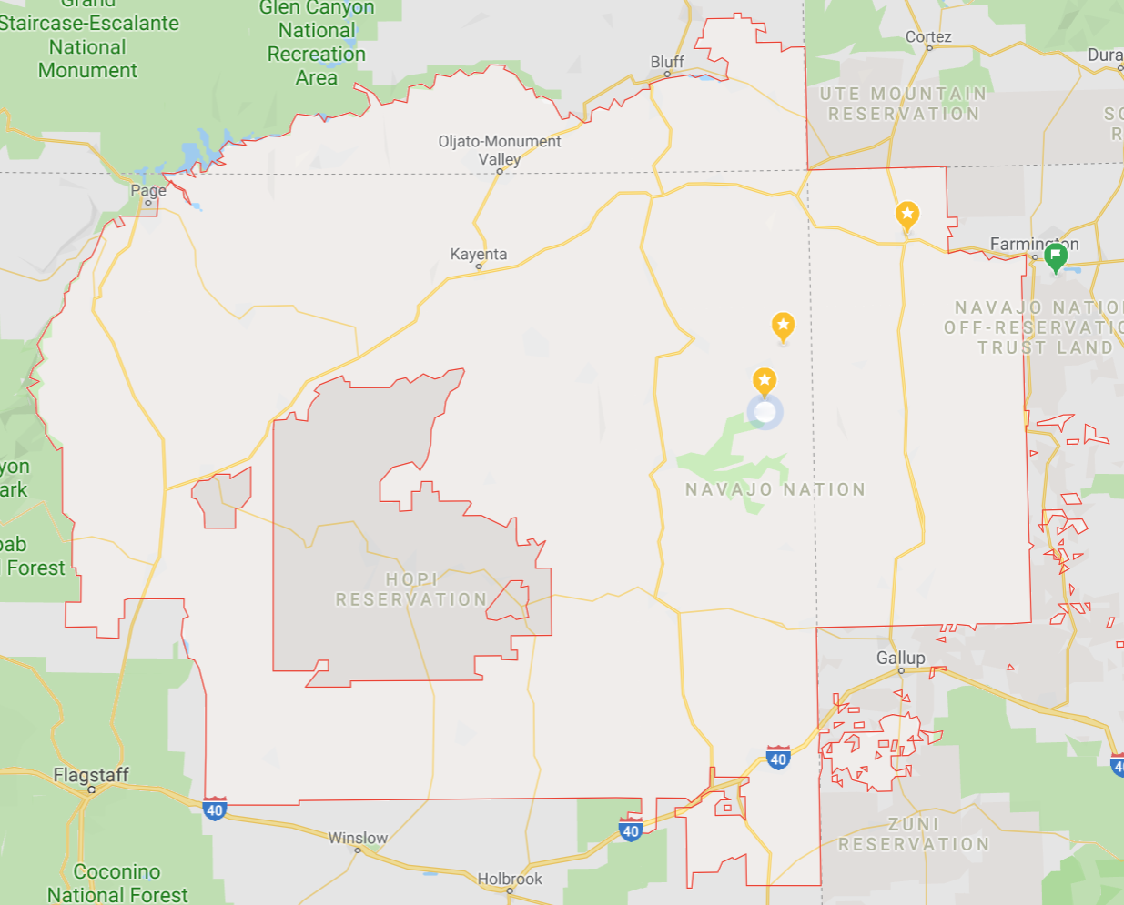
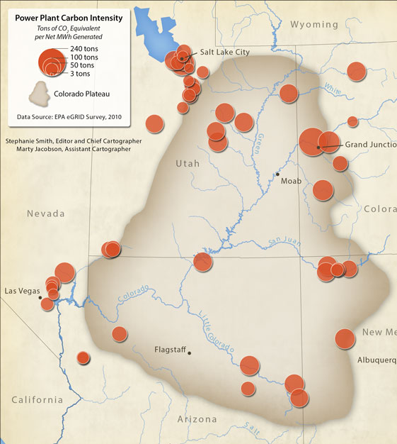
Carbon Dioxide within the Navajo Nation

Slide 17
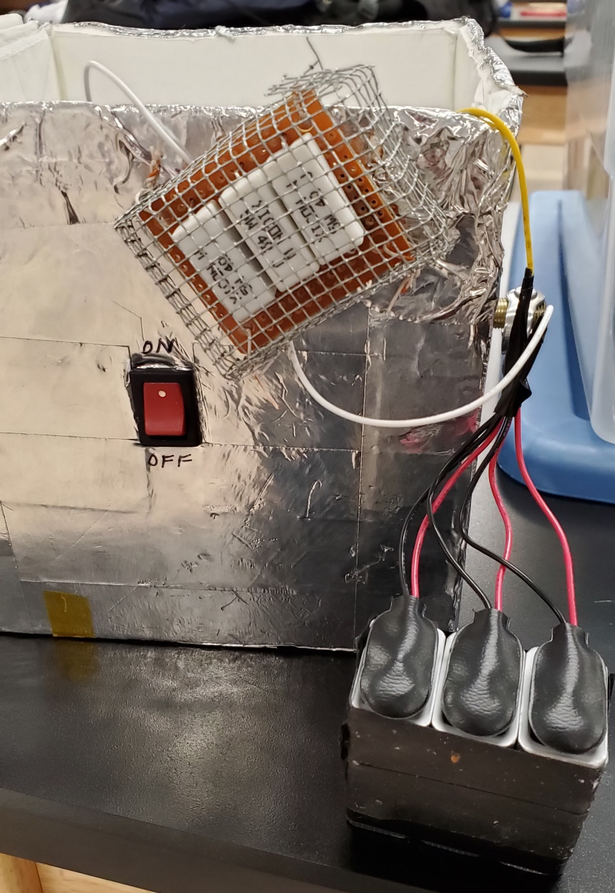

Construction of CO₂ Payload
Components:
Arduino Uno Board
Base Shield
MH-Z16 CO2 sensor
SD Sensor
SD Micro Card
Strip Board
Jumper Wires
9V batteries
Creating a code:
C++ programming
MH-Z16 sensor code
SD Sensor code
GetHub

Slide 18
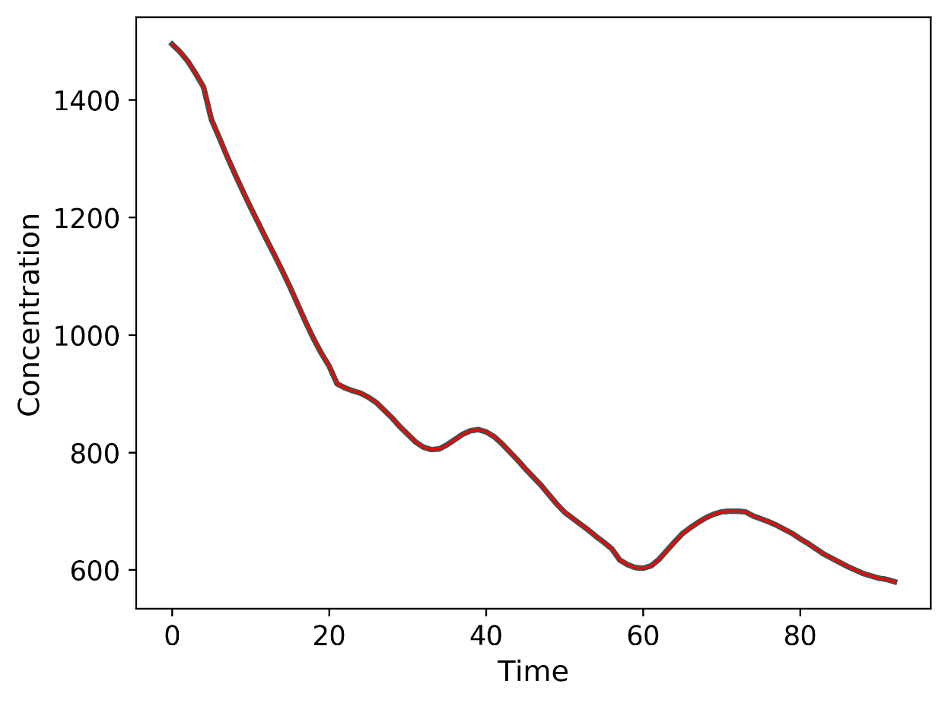
Results: CO₂ sensing hardware collected little-to-no data
Worked well in testing:
Clear sensitivity
Error-free data logging
Potential causes of failure:
Temperature
Physical stress or collisions resulting in hardware shutdown.

Slide 19
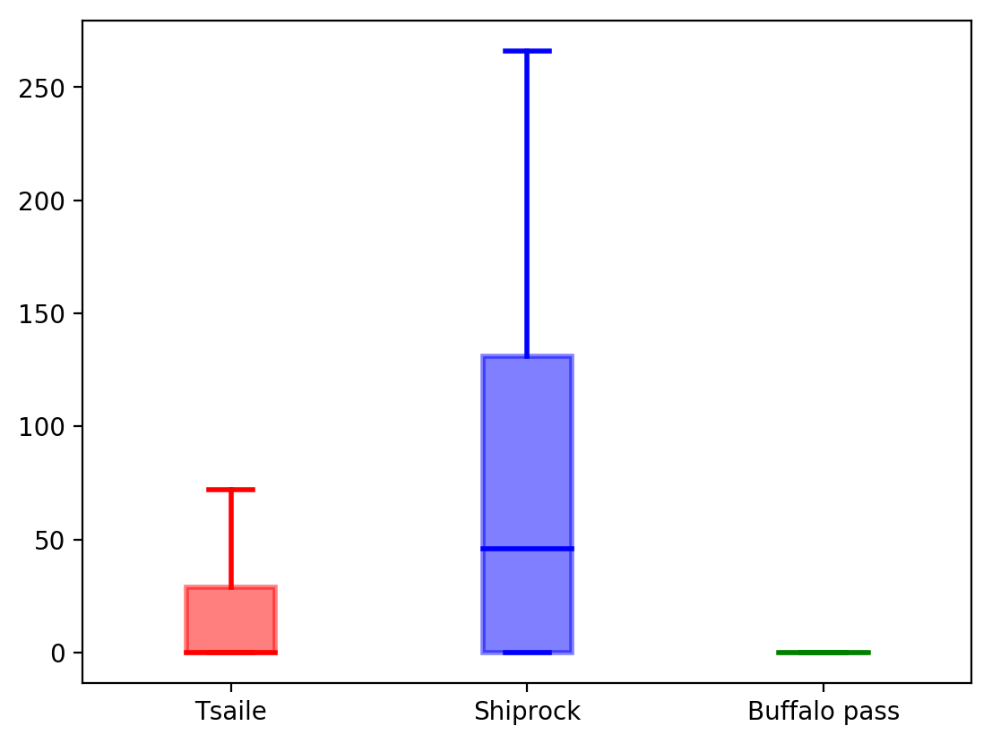
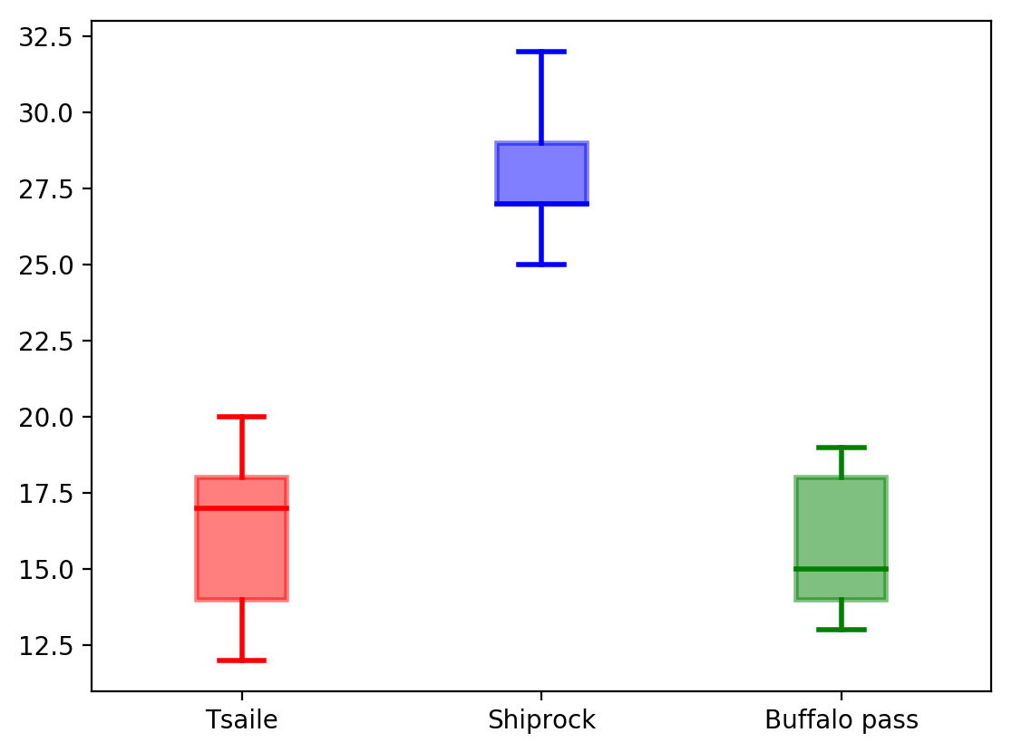
Plan B: Ground Level
(Plan A is always the first plan to fail)
Concentration, ppm (not calibrated)
Temperature, C (not calibrated)

